Slide 1
Finds in Visualization
The Dapper Squirrels

Slide 2
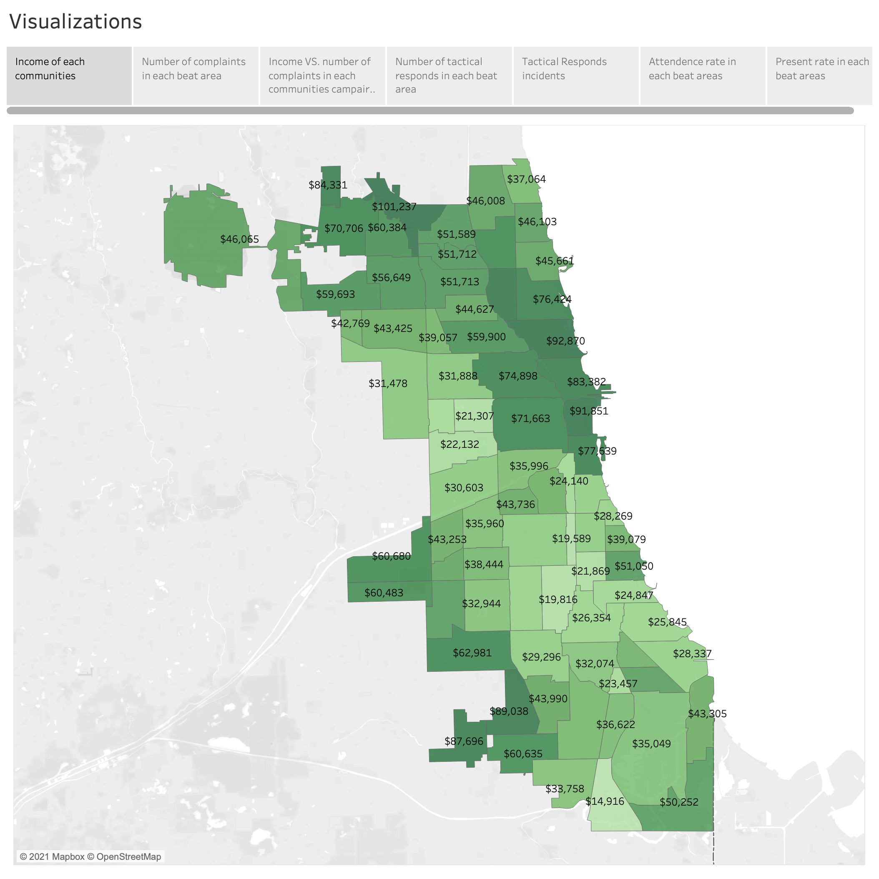
Visualizing something in the real world like a map is always attractive and easy to understand. So, we create an income map for all the areas in Chicago. Darker color means higher income in the region. This way, we can see the income level clearly in all areas, beats, and even streets. It also opens the door to a more thorough analysis of our analysis of income and community.
As we can see from the income map, areas with a similar level of income usually come from nearby areas. For example, high income in the northeast and southwest areas and low income in southeast areas. Also, different areas are drastically varied in their median income. The largest number gets as high as 100k, but the lowest number can be only over 10k. Typically, lower-income means more crimes in the area. When there are much more crimes in any area, there must be more possibility of over-policing. Furthermore, we can find out more details by correlating the income map with over-policing. So, we created the complaint rate map, which indicates direct correlations with low income as expected.

Slide 3
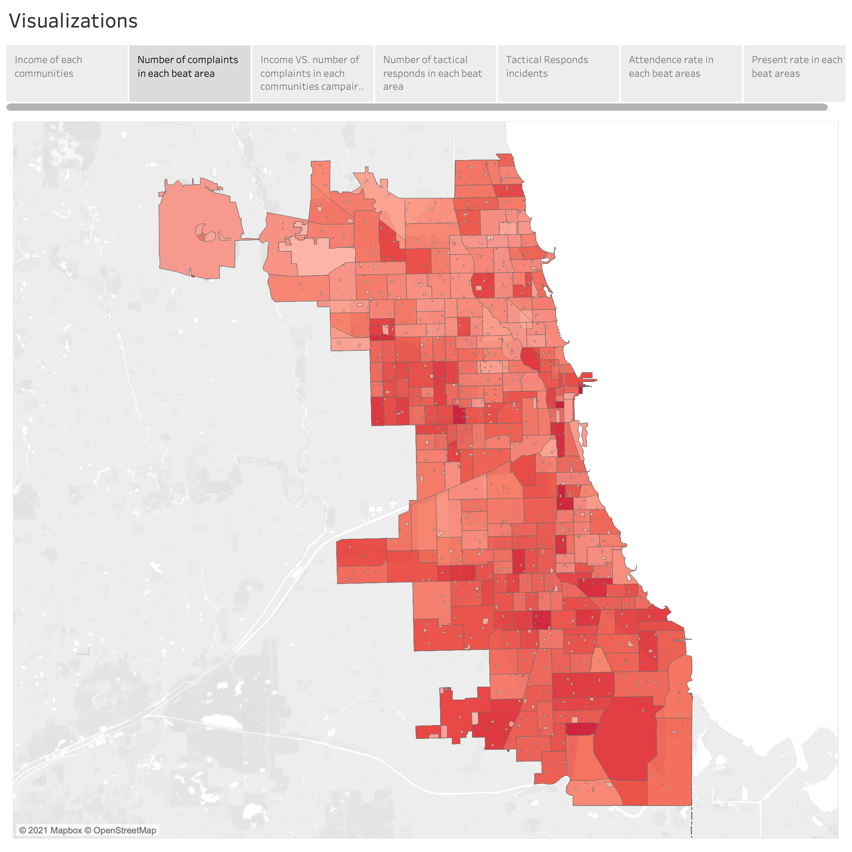
To investigate the relationship between complaint rate and locations, we made a heat map with the number of complaints in each beat area. By comparing this map with the income level map, we can find the relationship between income level and the number of complaints.

Slide 4
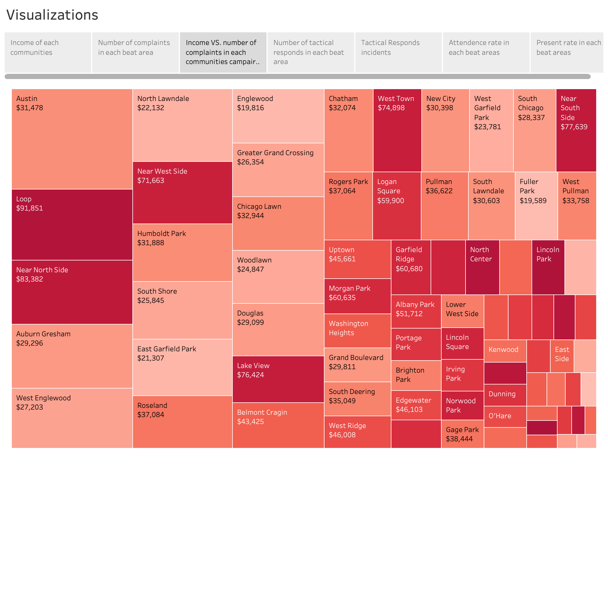
To make the observation clear, we also created a plot for the number of complaints in comparison with income levels in each community. Higher-income communities would bring deeper color to tiles, and more complaints would make the tile bigger. From this plot, we found that there are no significant patterns in income-complaints relations. More studies are needed.

Slide 5
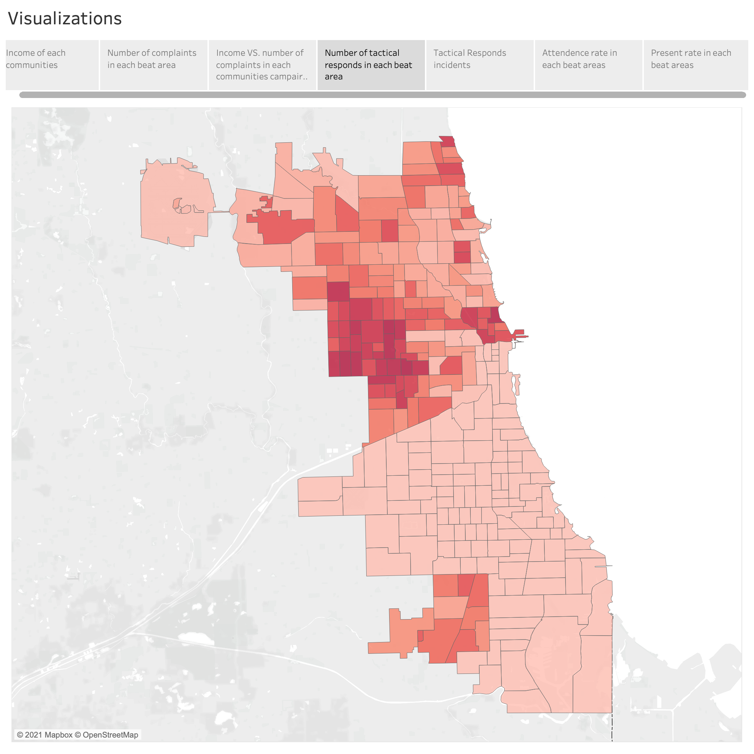
To investigate the relationship between locations, income, and complaint rate. We calculated the count of tactical responds in each area and every over-policing incident that happened in the past as a dot on the map(the next page). It is quite clear that there will be a high risk of misconduct in the low-income area. For example, in northeastern Chicago, a high-income area has the relatively lowest tactical respond rate.

Slide 6
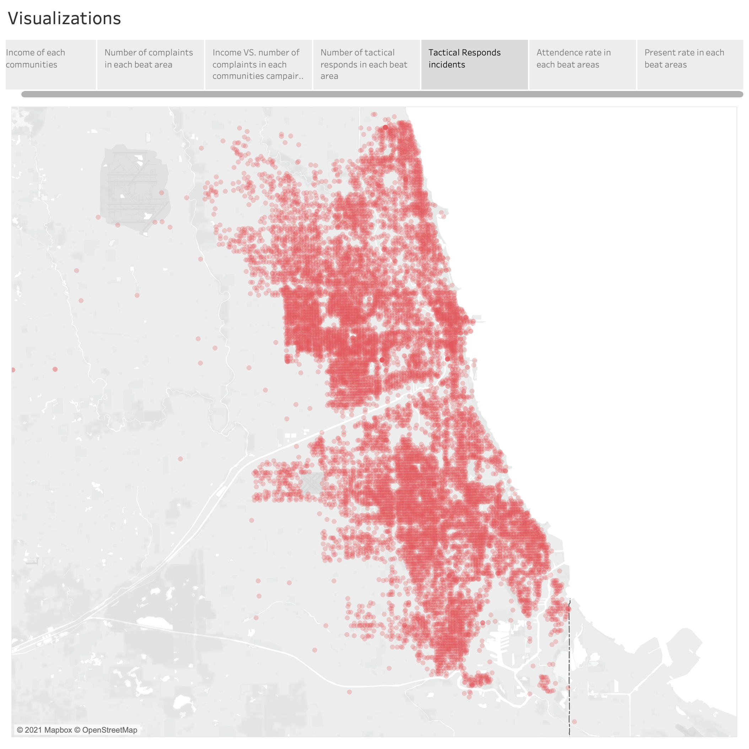

Slide 7
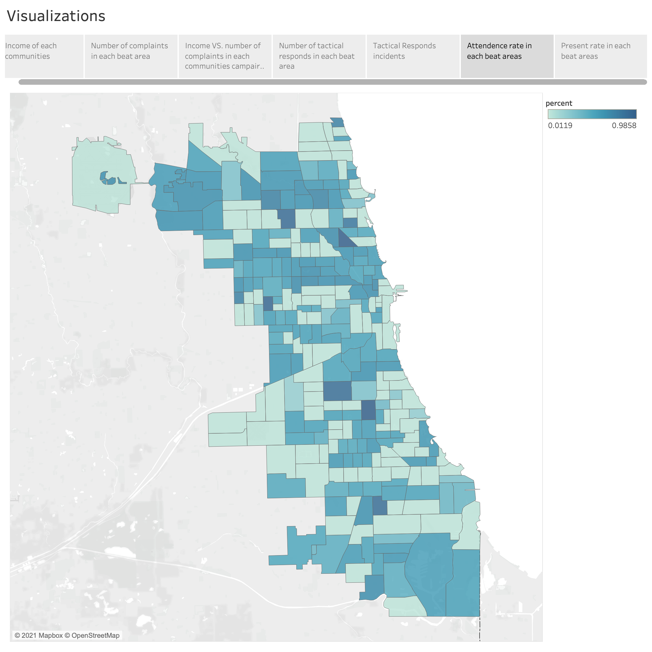
In this part, we would like to answer the question in the proposal, what are the officer hours are difficult to get in the given data source, we worked around it by calculating the presence rate in each beat area.
From the previous parts, we learned the relationship between income and the CRs or TRRs. But should we think about one question first, did every police officer goes to duty in every beat? There is a possibility that the low CRs and TRRs from the area are caused by low attendance.
This figure shows the percentage of attendances in different beats. For example, we put our view on the south area. The attendance rate in some low-income areas is near 90%. This is good, since officers here are willing to work, if there is no evidence of over-policing, then there is not.
However, there is some low-income place that has low attendance rate. If we also find there has a high volume of CRs, we should consider there is potential over-policing.

Slide 8
